Slide 1
The Shortage of Hospitals in Tennessee

Slide 2
Data acquisition and cleaning
The list of Tennessee hospitals came from downloading a csv file provided by the Tennessee Department of Safety and Homeland Security.
Tennessee county demographic information was scraped from en.wikipedia.org/wiki/List_of_Tennessee_locations_by_per_capita_income and then merged with the hospital list based upon with a left join to the hospital list. Demographic data that represented dollar amounts was imported a text, so the $ was removed, and the column type set to float.
The determination of whether a county is rural or not is based upon the US Department of Agriculture Rural-Urban Continuum Code.
There are 95 counties in Tennessee.
25 Counties in Tennessee do not have a hospital.

Slide 3
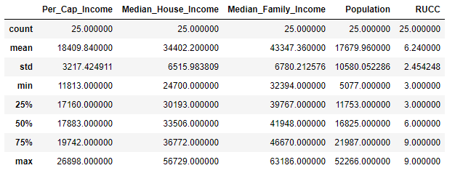
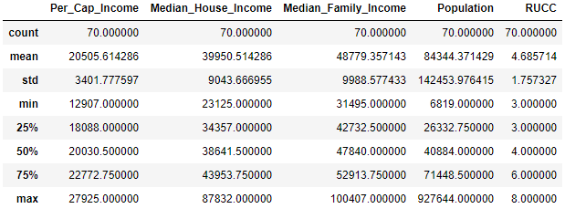
County data
Without a hospital
With a hospital

Slide 4
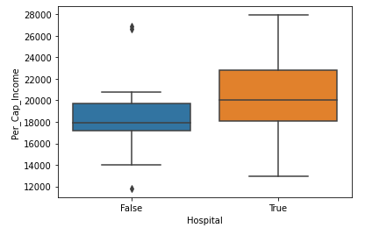
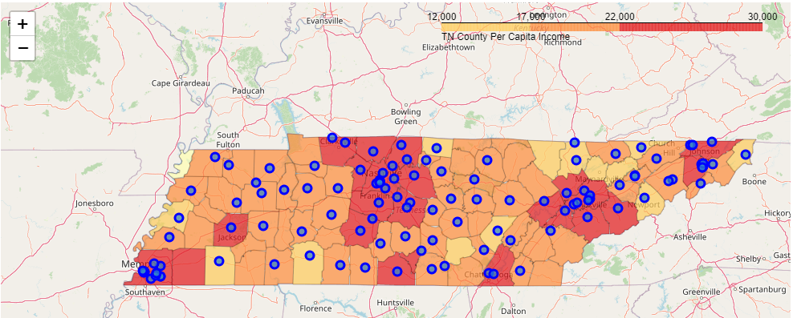
Per Capita Income
County map with blue dots denoting hospitals
State mean $19,954
No hospital mean: $18,410
With hospital: $20,506

Slide 5
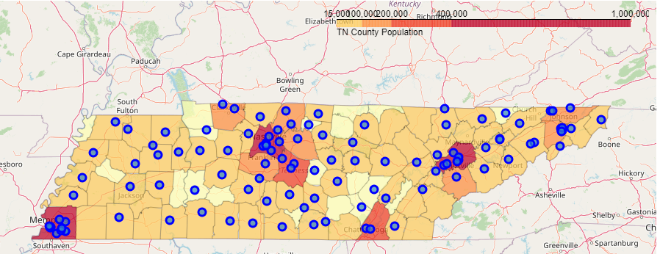
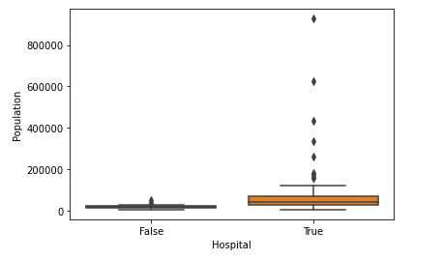
Population
County map with blue dots denoting hospitals
State mean 66,801
No hospital mean: 17,680
With hospital: 84,344

Slide 6
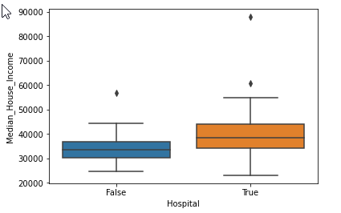
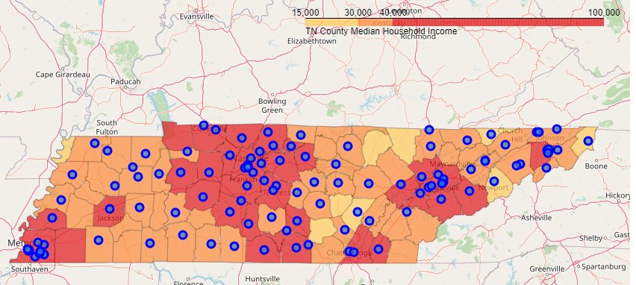
Median Household Income
County map with blue dots denoting hospitals
State mean $38,490
No hospital mean: $34,402
With hospital: $39,950

Slide 7
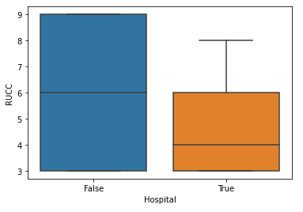
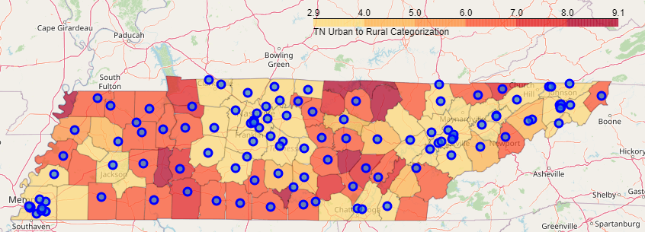
Median Household Income
County map with blue dots denoting hospitals
State mean: 5
No hospital mean: 6.24
With hospital: 4.69

Slide 8
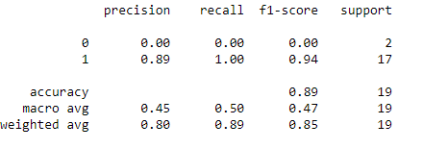
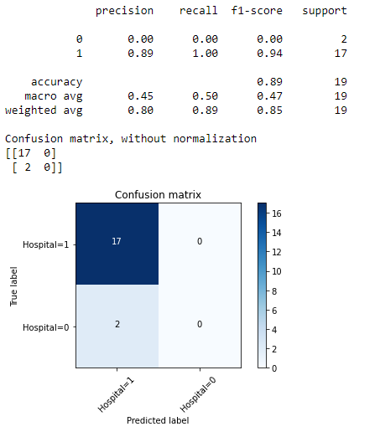
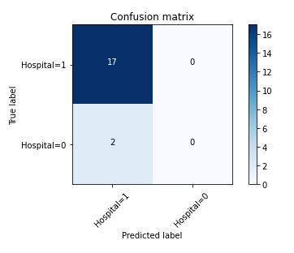
Logistic Regression vs SVC using RUCC
Using the RUCC score only, both Logistic Regression and SVC models give strong results predicting counties with hospitals, but neither model gives good results in determing that a county does not have a hospital

Slide 9
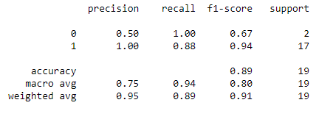
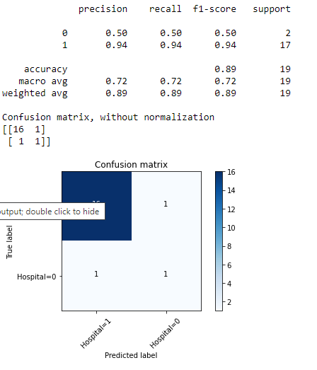
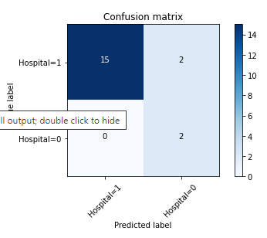
Logistic Regression vs SVC using RUCC

Slide 10
Result comparison of models
Weighted Avg | Precision | Recall | F1-score | Support
RUCC Logistic Reg. | 0.80 | 0.89 | 0.85 | 19
RUCC SVM | 0.80 | 0.89 | 0.85 | 19
All Logistic Reg. | 0.95 | 0.89 | 0.91 | 19
All SVM | 0.89 | 0.89 | 0.89 | 19
Using the RUCC score and demographic information, both Logistic Regression and SVC models give strong results predicting counties with hospitals, but neither model gives good results in determining that a county does not have a hospital. Logistic regression tends to have a better result with an F1-score of 0.91

Slide 11
The Shortage of Hospitals in Tennessee
Results
If you live in a Tennessee county that is classified as rural and not adjacent to a metropolitan area (RUCC=9), you do not have a hospital. Although a RUCC score of 9 is currently an indicator of no hospital, lower scores alone become problematic in predicting the presence of a hospital. Using the RUCC score along with population and income data allows us to better predict the absence of a hospital.
Conclusion
Sparse populations and the lack of available capital together seem to be the best indicator of not having a hospital. Given a small hospital costs $52,200,000 to build, the economic reality is that it takes a certain amount of people with sufficient income to make a hospital economically viable.
There are 3006 counties in the U.S. so this study only took into account 3% of the counties available. A larger sample size might allow us to have a better understanding of what causes hospital deserts, and allow community leaders to act decisively on behalf of their citizens.

